Slide 1

PID NO 10
(46) Parag Patil
(06) Ojas Ambekar
(45) Kiran Patil
(43) Akshat Patil
(13) Atharva Bhandurge
(34) Akshay Mahajan
(58) Parimal Shinde
PID NO 10

Slide 2

CONTENTS:-
TOPICS UNDER CONSIDERATION
INTRODUCTION TO METAVERSE
WHY WE CHOSE METAVERSE
PROBLEMS RELATED TO METAVERSE
STAKEHOLDERS
SURVEY-1
SURVEY-2
UNLOCKING METAVERSE WITH AI
AVATARS
DIGITAL HUMANS(CHAT BOTS)
Conclusion
PID NO 10

Slide 3

TOPICS UNDER CONSIDERATION
1)METAVERSE
2)DIGITAL SECURITY
3)ELECTRICAL VEHICALS

Slide 4
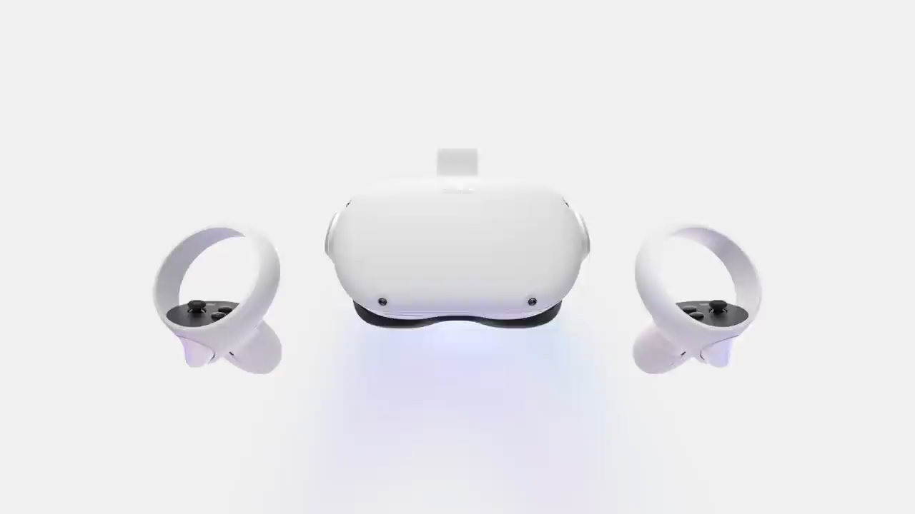

Slide 5


The main reason the Metaverse is important due to its industry and process-agnostic nature. Like the internet, one could apply it to virtually any use case – from gaming to work, and socialization to research. It has the potential to transform every aspect of our lives, both in our professional and personal spheres.
PID NO 10

Slide 6
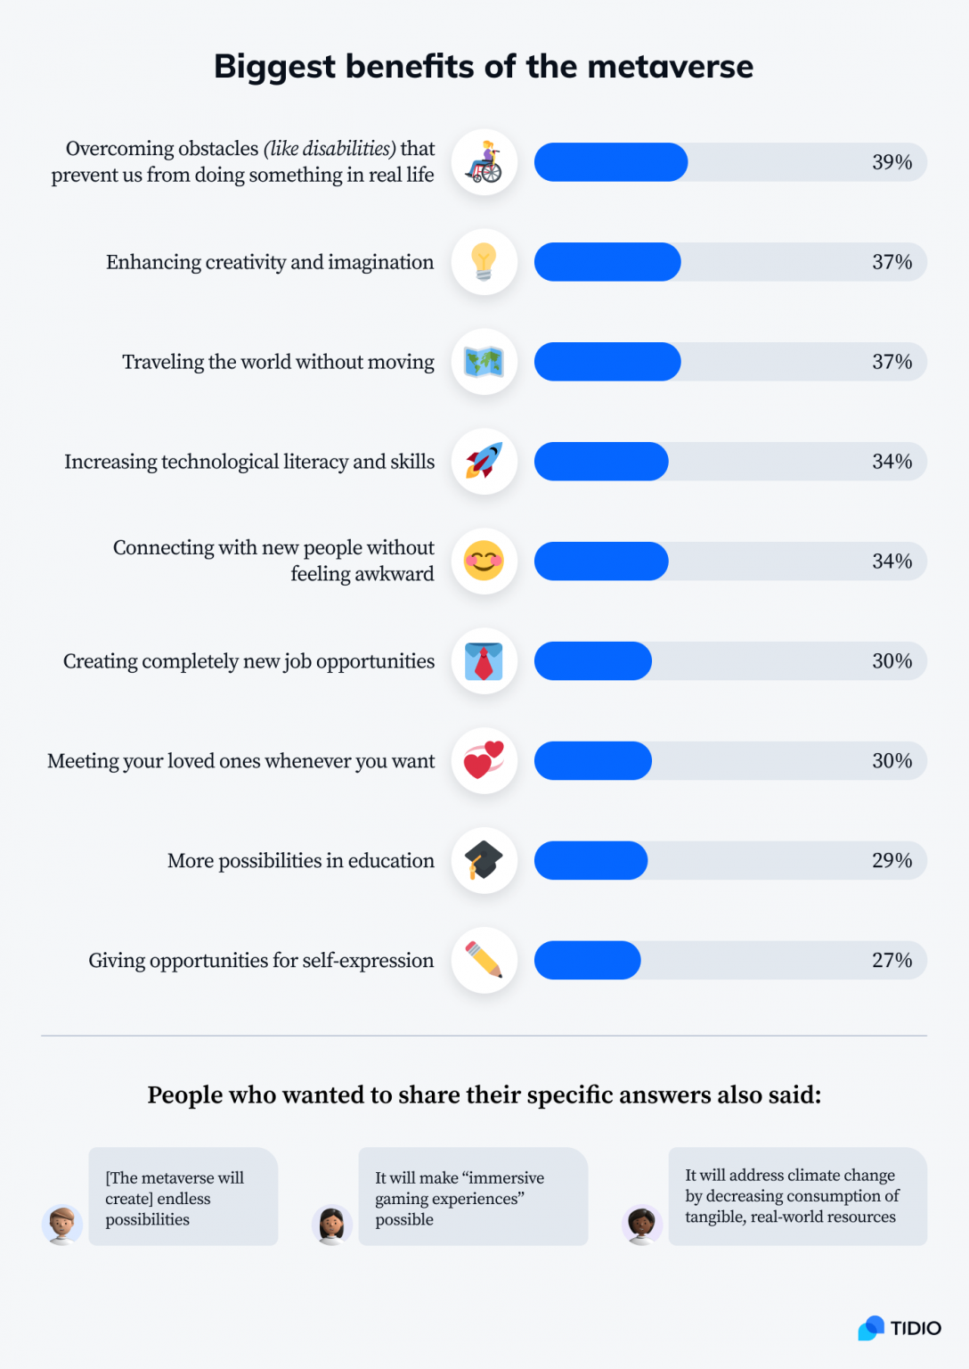
SURVEY-1
SOURCE-TIDIO
SURVEY SAMPLE-1000
PID NO 10

Slide 7
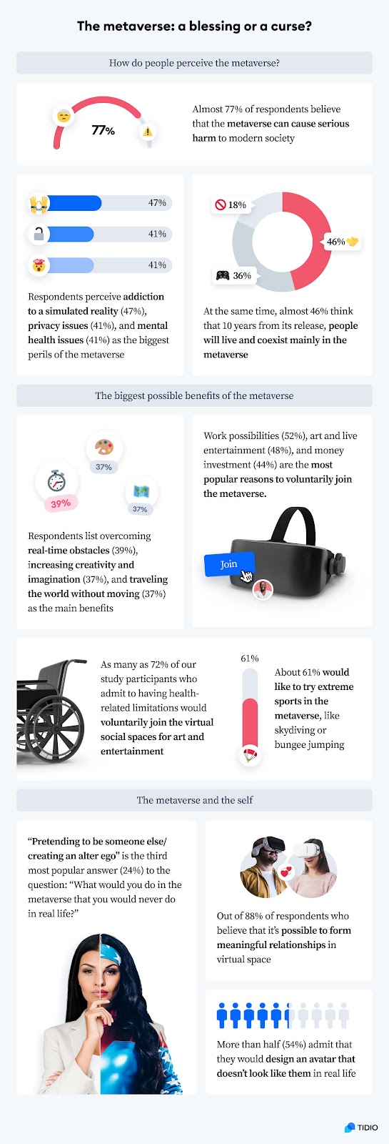
SURVEY-2
PID NO 10
SURVEY SAMPLE-1000

Slide 8

Problems We Identify
Hardware
Identity
Privacy & data security
Addiction and mental health
PID NO 10

Slide 9
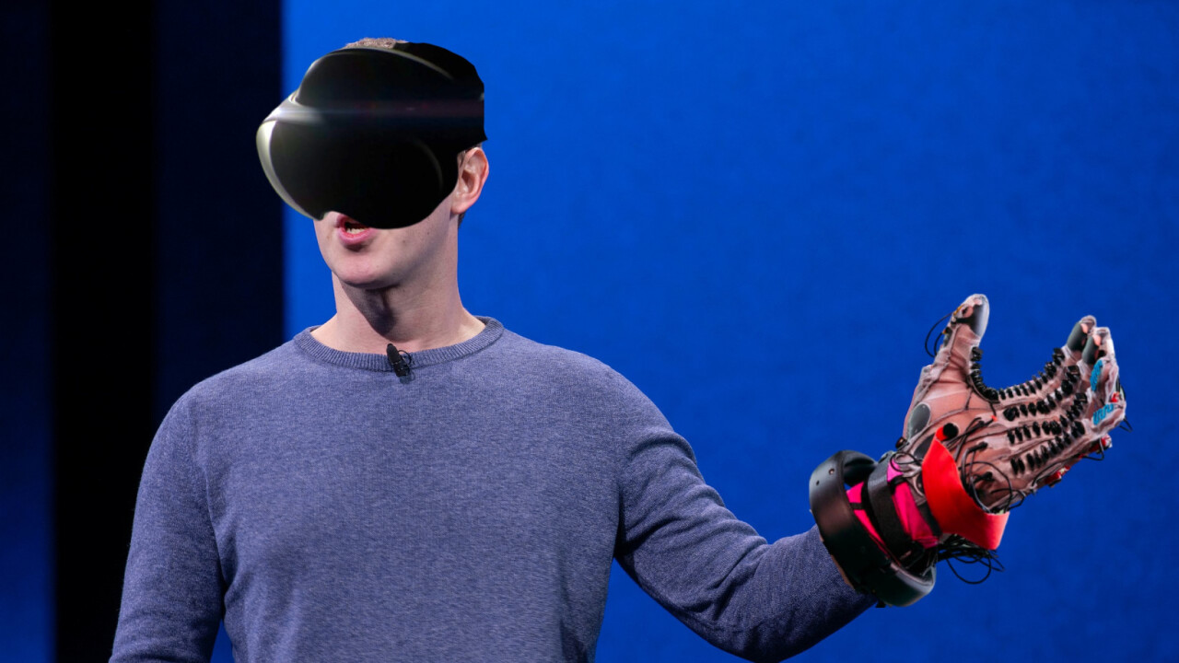
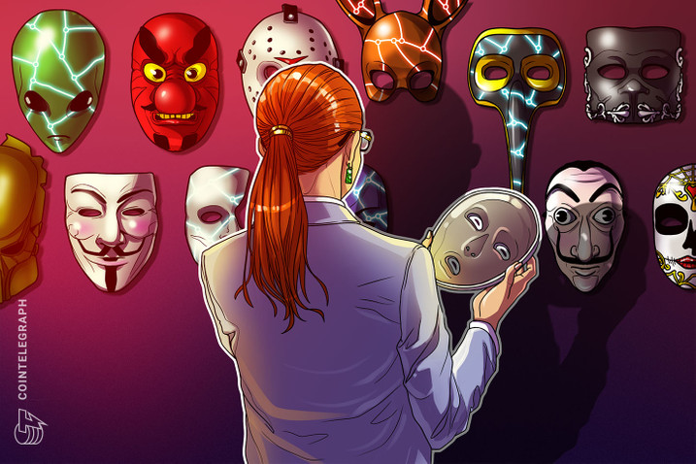
Problems
Hardware, Identity
Hardware
Identity
Affordability
Uncomfortable
Negative impact on user
Stealing of Identity
Evil Twin
Digital E.L.F
PID NO 10

Slide 10


Problems
Privacy & data security, Addiction and mental health
Privacy & data security
Addiction and mental health
Malware Invasions
Phishing Attacks
Invasion of User Policy
Isolation
Obsession
Desensitization
PID NO 10

Slide 11
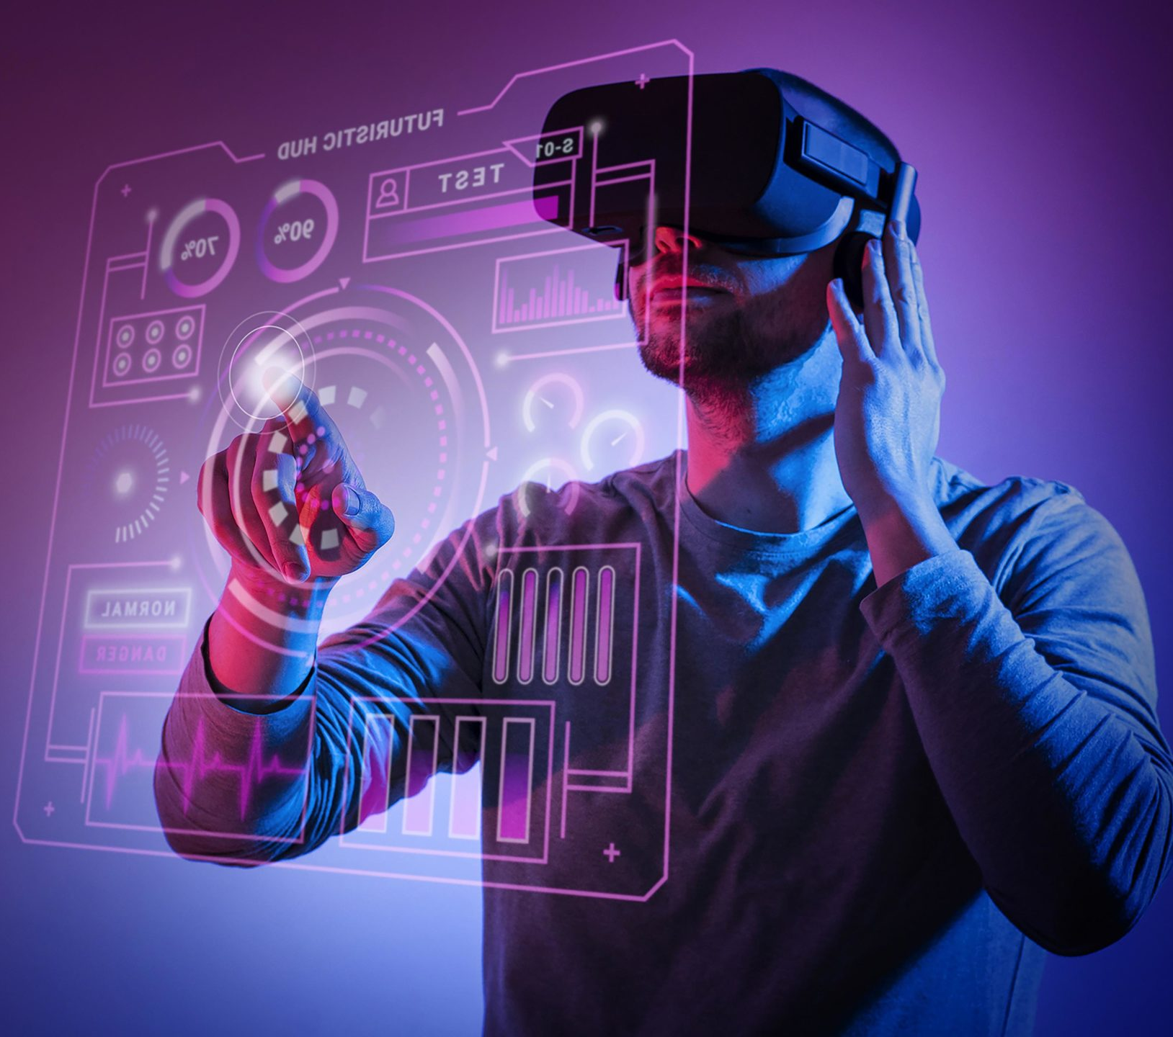

STAKEHOLDERS
1)Facebook(Meta)
2)Alphabet(Google)
3)Microsoft
4)Nvidia
5)Adobe Systems
PID NO 10

Slide 12
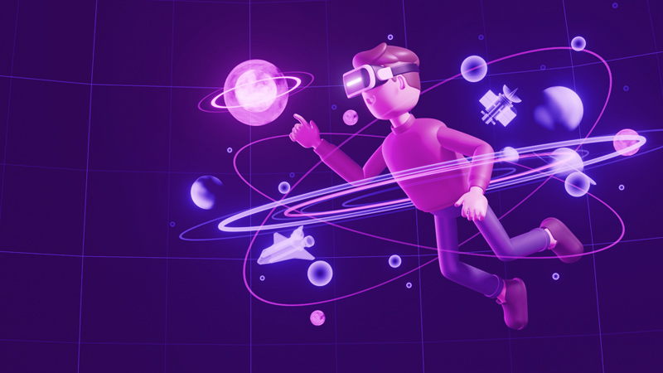
UNLOCKING
METAVERSE
WITH
ARTIFICIAL
INTELIGENGE

Slide 13

AVATAR
One of the most interesting and spoken about concepts of the Metaverse is Avatars. People are creative and love the thought designing themselves in a virtual world. They can change their hair colour, style of clothing to their preference. AI has the ability to analyse 2D user images or 3D scans to create very realistic and accurate Avatars. Companies such as Ready Player Me have already actively been using AI to help build Avatars for the Metaverse.
PID NO 10

Slide 14
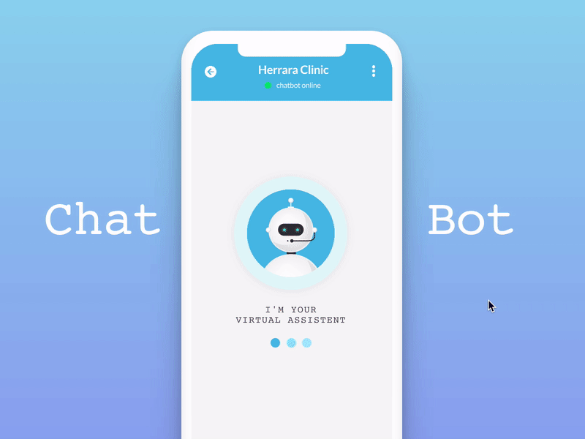
2. Digital Humans Digital humans have the ability to see and listen to users to understand what they are saying. They can also use speech and body language to create human-like conversations and interactions.
Digital humans are purely built using AI technology and are an important element to the construct of the Metaverse. Digital humans can range from NPC’s to automated assistants in the VR workplace.
PID NO 10

Slide 15
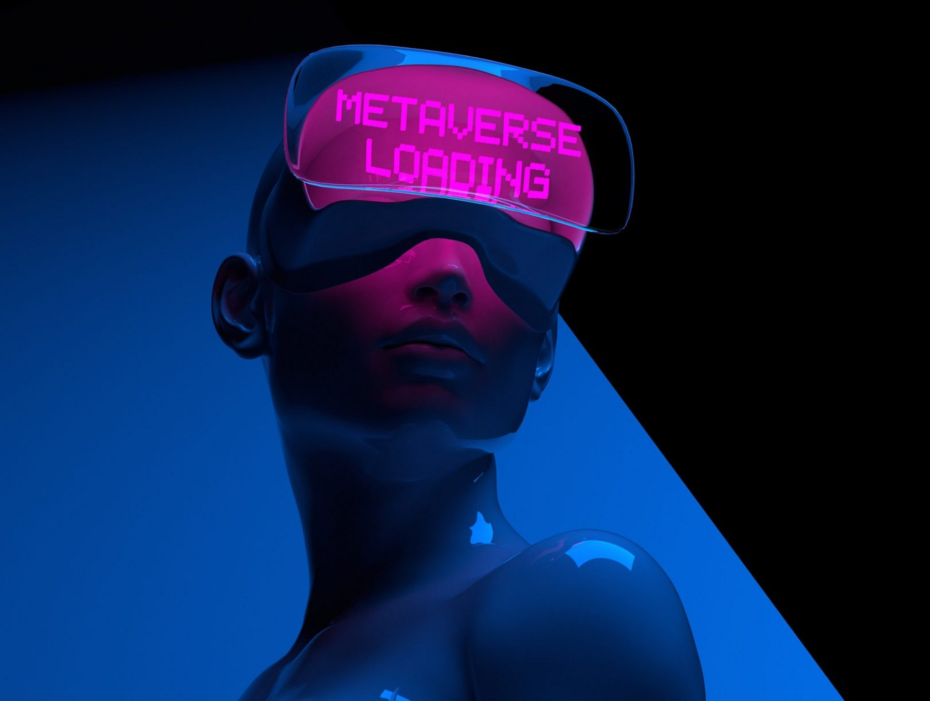
Conclusion
Creating a Metaverse could be challenging and full of opportunities even though we are still only on the threshold of a virtual universe.
There is no doubt that we must ensure that the Metaverse complements our real-world rather than replacing it.
In this vast new universe, we need to remember to remain aware, safe, and secure as much as we can look forward to the virtual world.
PID NO 10

Slide 16

Thank You
PID NO 10

